Slide 1
World Happiness Report
April 30, 2022

Slide 2
Introduction
1

Slide 3




Hello!
Taji Abdullah
Anthony Garcia
Justin Kiang
Pooja Mahajan

Slide 4
Data Source
World Happiness Report 2021
https://www.kaggle.com/datasets/ajaypalsinghlo/world-happiness-report-2021

Slide 5

The World Happiness Report is produced using data from the Gallup World Poll.
This data is categorized by six categories: economic production, social support, life expectancy, freedom, absence of corruption, and generosity.
Based upon the respective score in these categories, an overall score is generated for 149 different countries.
Our project shows the “happiness” rankings of 149 different countries using a choropleth map, among other visualizations.

Slide 6
Exploratory Data Analysis
2

Slide 7
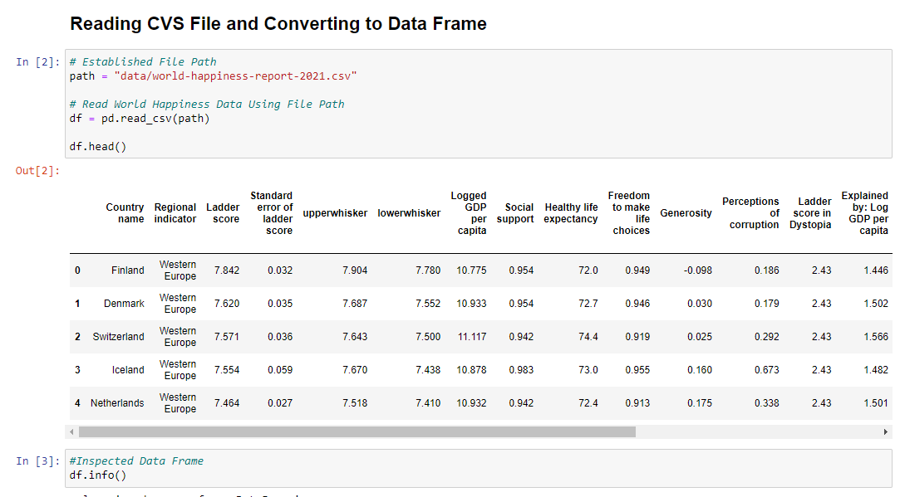
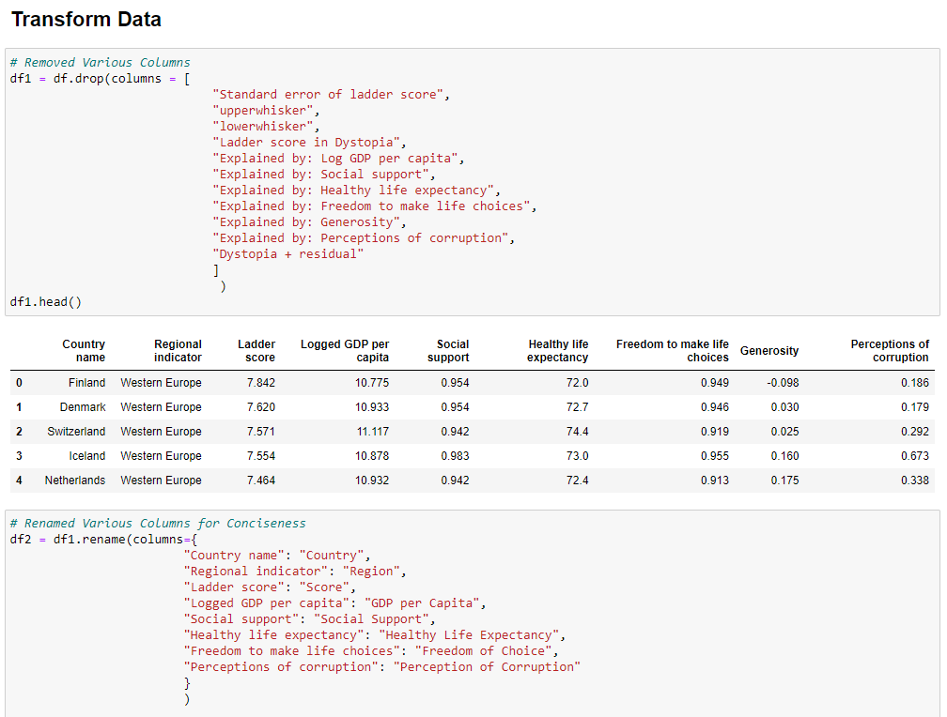
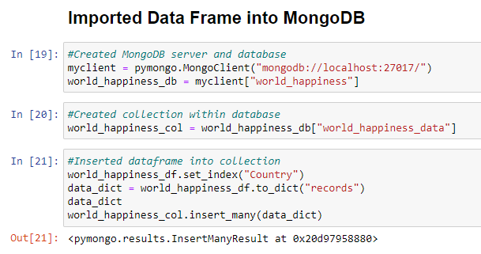
Exploratory Data Analysis

Slide 8
Data Limitations
One
Happiness Scores were not available for 106 of 255 countries, which likely skewed the happiness index to be higher for the western nations.
Two
The dataset was also limited to 1 year (2021), hence happiness trends for countries could not be evaluated.
Three
The scores appear to be based on surveys conducted, however, our team did not have access to them.

Slide 9
Steps Taken in the Extract, Transform, and Load Process and Beyond
Loaded the CVS file, which contained happiness data for 149 countries, and converted it to data frame
Merged both data frames so that all 255 countries when in one data frame
Created a Web Application using Flask that converts the cleaned data into a “.json” format, which stored it onto local server as an API
Created an HTML file to display the Plotly dashboard on a webpage.
2
4
6
8
Established dependencies
1
3
5
7
Loaded geojson data, which contained geographical coordinates for all 255 countries/territories in the world, and converted it to a data frame
Imported data frame into MongoDB, because SQL does not accept any form of geometry data
Utilized the API to load the data with D3 on JavaScript and create the Plotly dashboard.

Slide 10
Data Analysis
3

Slide 11
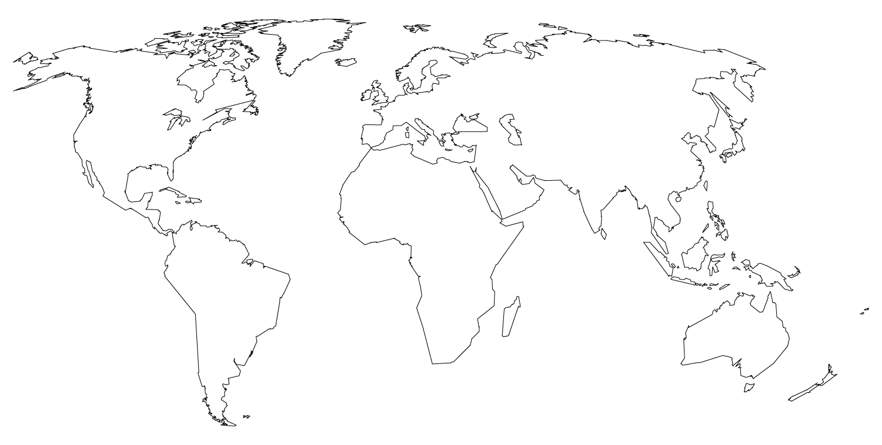
Grouping the data by region and analyzing the averages showed the following:
1. Australia and New Zealand have the highest rank and happiness score, followed by Western Europe and North America
2. Sub-Saharan Africa has the lowest, followed by South Asia, and Middle East and North Africa

Slide 12
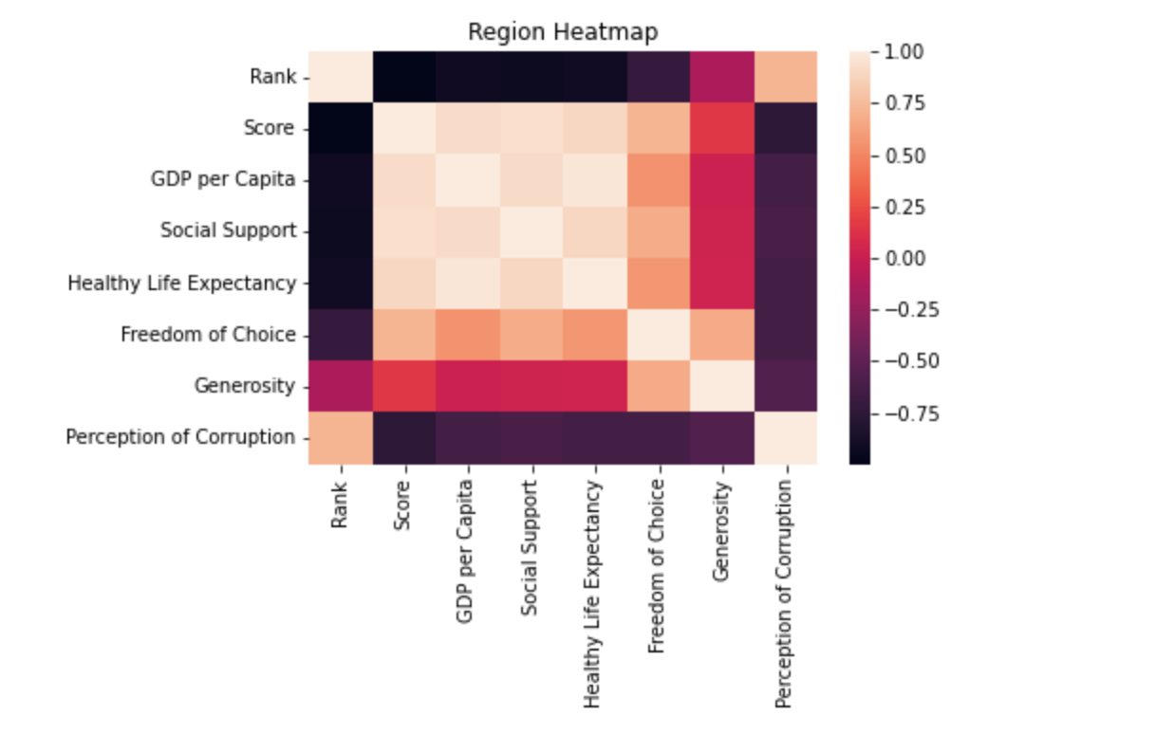
Region Heatmap

Slide 13
The Happiness Score is…
One
Strongly correlated to GDP per Capital, Social Support, and Healthy Life Expectancy
Two
Moderately correlated to Freedom of Choice and Generosity; and
Three
Negatively correlated to Perception of Corruption.

Slide 14
Conclusion
4

Slide 15
Conclusion
90% of the top 10 countries with the highest happiness score are in Western Europe
Developing nations, located in Africa and Asia, had the lowest happiness score
The low scores can be attributed to low industrialization and low human development (education, income, quality of life etc.)
Other than the six categories used in this analysis, there may be additional factors to further evaluate the happiness index

Slide 16
Thanks!
Any questions?

Slide 17
Appendix
5

Slide 18
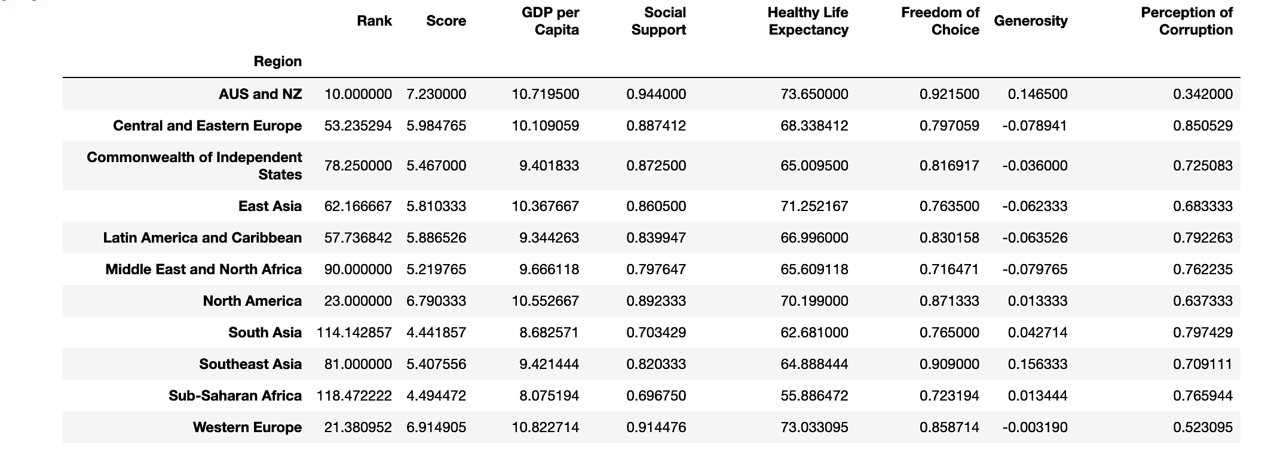
Group by Region

